Slide 1
SMART TRAVEL GUIDE
APPLICATION FOR ANDROID MOBILE

Slide 2
INTRODUCTION:
Nowadays, people’s consumption structure is improving steadily. There has been a large increase in the number of people out on tours, for the sake of recreation and entertainment.
Tourism is the strongest and largest industry in the global economy world, generating an estimated 11% of the global gross domestic product (GDP)
and employing 200 million people and serving 700 million tourists worldwide-a figure which is expected to double by the year 2020.
Meanwhile, there is greatly enriched travel information provided to the tourists on the Internet.
However, a problem is shown that tourists are not able to get travel information timely when they are on the move.
Therefore, we intend to explore how to build a mobile tourist guide system based on mashup technology to solve this problem .

Slide 3
Current mobile services are enhanced with location aware features, providing the user with better use experience.
A great number of mobile phone applications appeared recently, many of which are location-related.
We will describe the design, implementation and deployment of a location-based application, named
Smart Travel Guide, with the mobile phone as a platform.
This application permitted users to get tour guidance
information they need anytime and anywhere.
In particular, the tourist data could be browsed or queried through an Internet map service such as Google Maps.
GPS has become a mainstay of transportation system worldwide. It provides accurate location information for an unlimited number of people anywhere in the world.

Slide 4
GPS satellites broadcast signals from space which are picked up and identified by the receivers
Then the receiver are provided with three dimensional locations: latitude, longitude and altitude. If the user device includes a GPS (Global Positioning System) module which is becoming increasingly common in current mobile devices, the user’s location can be defined very accurately .

Slide 5
Advantage & Disadvantage of Existing System:
In the tourism industry, tourist information is obtained mainly through newspaper, magazines, radio and other simple ways those are available easily.
But problem is that tourists are not able to get travel information timely when they are on the move.
While today's mobile devices are becoming more intelligent,
compared with PC, they still have the following limitations like small screen and tiny keyboard, limited CPU capacity, limited memory space, slow and fitful Internet connection.
Many mobiles of recent decades have travel guide application. But the application on these mobiles works slow due to continues acquisition of the bandwidth.
Therefore, the mobile end-user’s operation is very difficult.

Slide 6
Basic Concept of Application
The application aims to develop detailed texts, pictures, videos and other guidance information are provided, and so people can better understand the tourist attractions and make decision objectively.
A problem is shown that tourists are not able to get travel information timely when they are On the move.
Therefore, we intend to explore how to build a mobile tourist guide system based on mashup technology to solve this problem.

Slide 7
Modules in Application
Find Current Location.
Locate in Map.
Calculate Distance between two Cities.
Video Search.
Weather Forecast.

Slide 8
RELATED WORK
Mobile Tourist Guide System Based On Mashup technology is a useful for this application.
Mashups based on open web APIs have shown the power of integrating applications and data sources to create novel and situational services to serve needs of users.
A Mashup can combine two or more data sources (content or service) to provide several new services or contents to the users. More importantly, it is a lightweight web application program.
The data or contents are mashed up in the Mashup server side. Furthermore, no matter what the mobile client is a Web browser or not, it is able to understand the format of the data or contents. The advantage of mashup technology is greatly exploited for the application of mobile devices.

Slide 9
System Details
In this section the detail overview of the system is given.
It includes System architecture which describes the basic architecture of system, main components of Mashup Server, Communication protocols, working flow of the system.
The architecture of this system contains three layers: presentation layer, logical layer and Data Sources layer.

Slide 10
Communication Protocols
The communication is a very important link of the system. It is to connect data or contents with each layer.
Although WSDL (Web Services Description Language), SOAP, JSON(JavaScript Object Notation) and REST are the standard for delivering data or contents between mashup server and data sources, REST is abstraction mode which is a more effective for the server mode.
Compared to SOAP, it is more like structure style, not only a specification, so the complex protocols are not taken into account.
Therefore, we choose REST to communicate among mashup server, Google Maps.

Slide 11
The Working Flow of the System
the mobile tourist guide system. First of all, we assume that the mobile end-users have already registered with the the working flow of the application in details.
In Step1, 2, 3 the mobile end-user logs on the system through the mobile web browser on his/her mobile device and sends request to the mashup server. To respond, the mashup server returns a Web page to the mobile Web browser.
At the same time, the Web page will trigger the GPS (Global Position System). It is necessary to add a timer to the Webpage, so that the GPS is able to update user’s geographical positioning information to the mashup server in time.

Slide 12
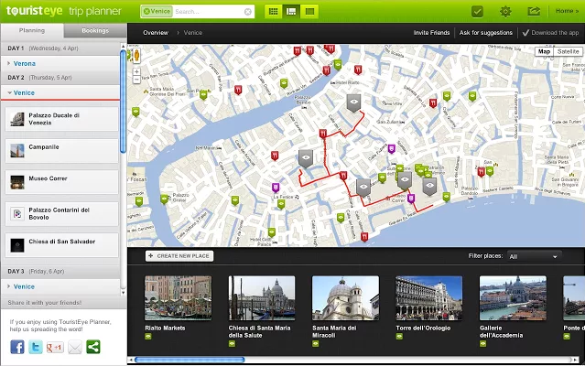

Slide 13
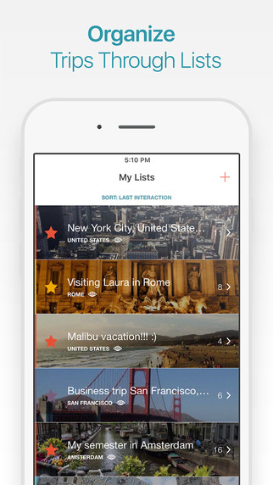

Slide 14
CONCLUSION
In this paper, we presented the design and implementation of a mobile application called Smart Travel Guide, with which mobile users can get tourism guidance information they need anytime and anywhere.
By Smart Travel Guide, users can get an attraction’s detailed information, including text, picture and video.
In particular, Smart Travel Guide can provide users with location-based information, which can be browsed or queried through a map.
User can search the nearby attractions after he or she configures the distance between the current location and the view spots. When the user moves out of the current location, the mobile phone will automatically.

